Slide 1
打造嶄新的你 A New You
Margaret Chan
總顧問經理級經銷商 National Supervising Coordinator
四個佣金週期共賺取HK$76,600
HK$76,600 in 4 Commission weeks
本簡報中提到的收入等級純屬舉例說明，無意代表美安香港經銷商的一般收入，也無意表示任何經銷商皆可賺取同等收入。美安香港經銷商的成功與否，取決於其在發展事業時的努力、才能與投入程度。The income levels mentioned in the following presentation are for illustration purposes only. They are not intended to represent the income of a typical Market Hong Kong Distributor, nor are they intended to represent that any given Independent Distributor will earn income in that amount. The success of any Market Hong Kong Independent Distributor will depend upon the amount of hard work, talent, and dedication which he or she devotes to building his or her Market Hong Kong Business.

Slide 3
美安4大基石 MA 4 Cornerstones
管理業績紅利計劃Management Performance Compensation Plan
產品代理/互聯網銷售Product Brokering / Internet Marketing
超連鎖™事業發展系統UnFranchise™ System
hk.shop.com/youronlineshop
1 對 1 行銷/社交購物One-to-One Marketing & Social Shopping
hk.shop.com/你的網上商店

Slide 4
未來趨勢
Future Trend
營養與健康
打造你自己的事業
NUTRITION &
WELLNESS
OWNING YOUR OWN BUSINESS
網絡／流動購物
社交購物
ONLINE/MOBILE
SHOPPING
SOCIAL SHOPPING

Slide 5
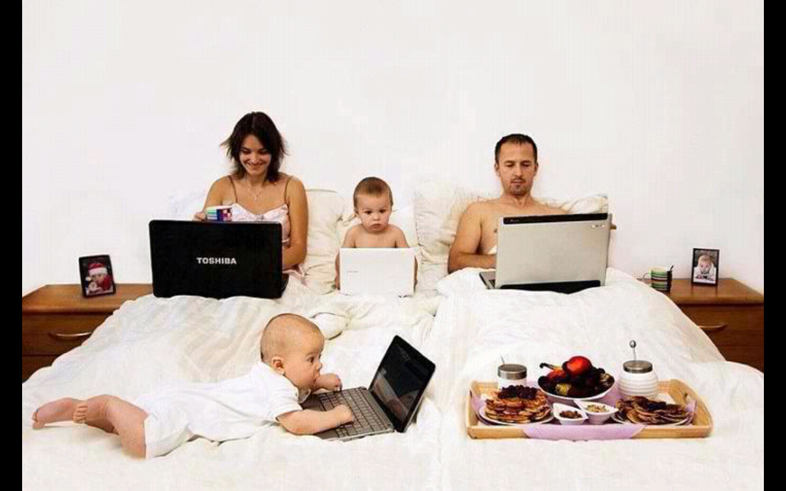

Slide 6
看新聞 Reading News
以前 In the Past
現在 Now

Slide 7
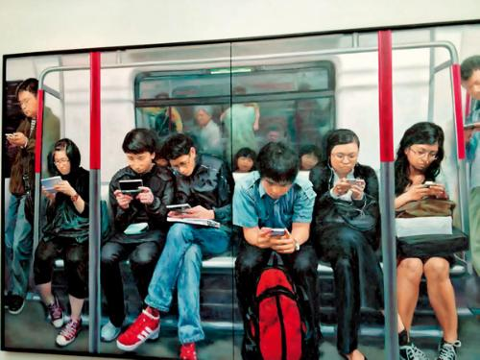
Here yet?
Yes!

Slide 8
趨勢是 The Trend
無論你認同不認同
無論你相信不相信
都是會發生的
重點是你如何看待……
No matter if you agree or disagree,
Or if you believe it or not,
It will happen.
The point is how you look at it…

Slide 9
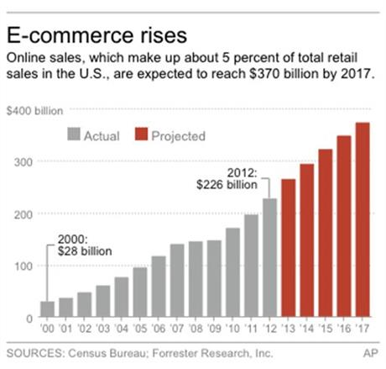
網際網絡市場持續強勁增長
Online Sales Grow Constantly and Rapidly

Slide 10
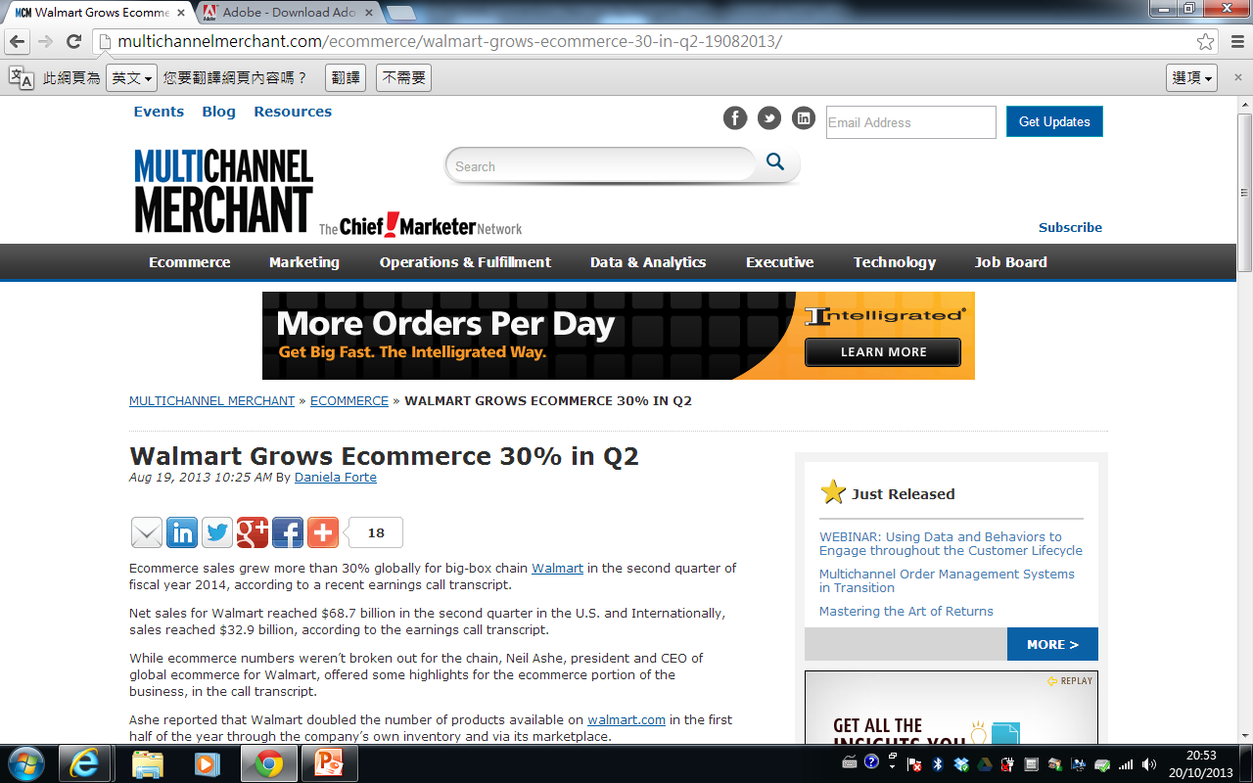
Walmart 今年網上銷售業積 – 第2季增長30%

Slide 11
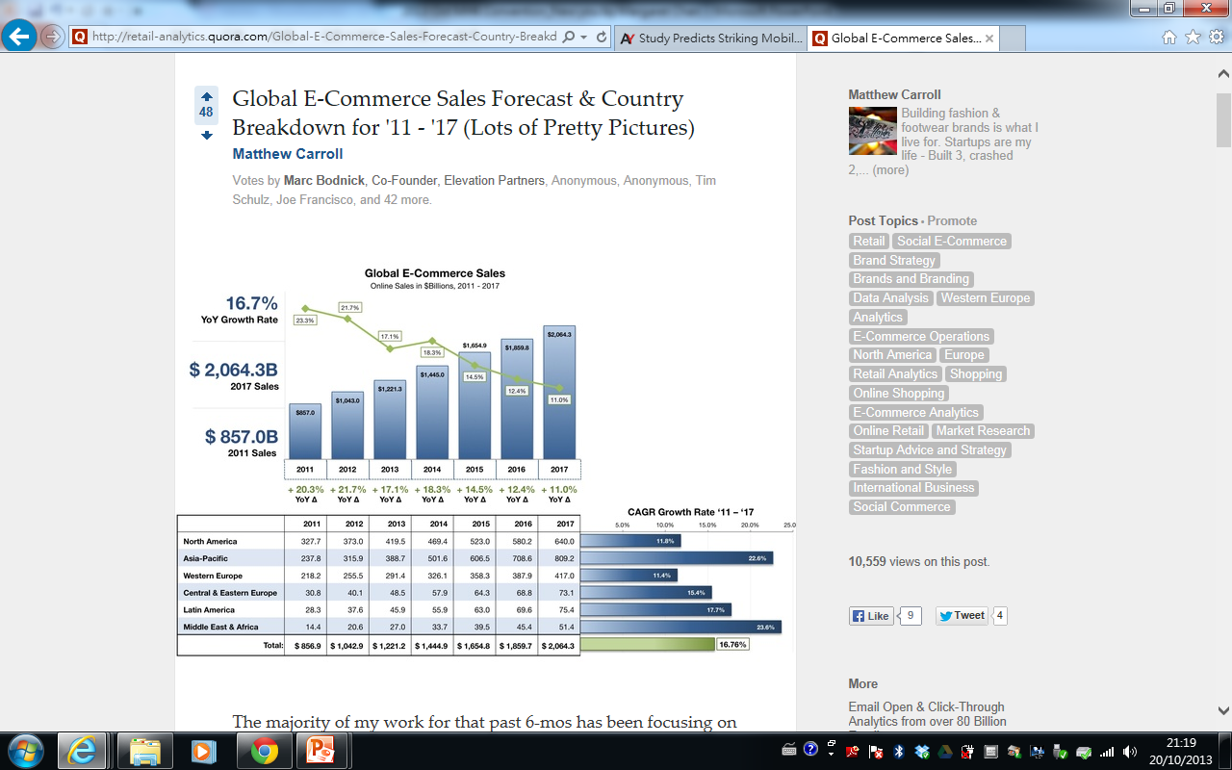
2011-17年全球電子商務銷售預測

Slide 12
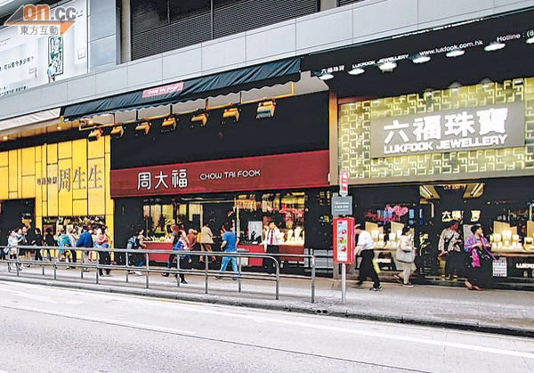
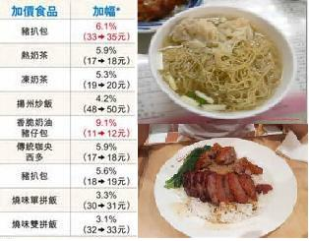
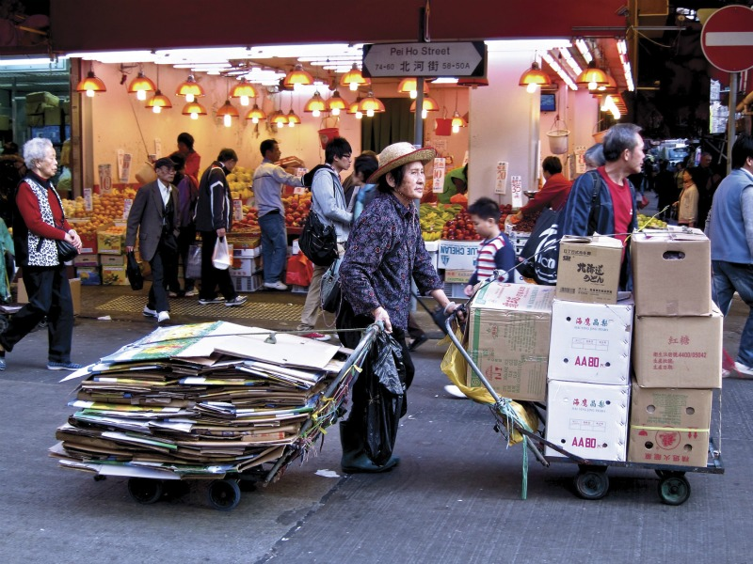
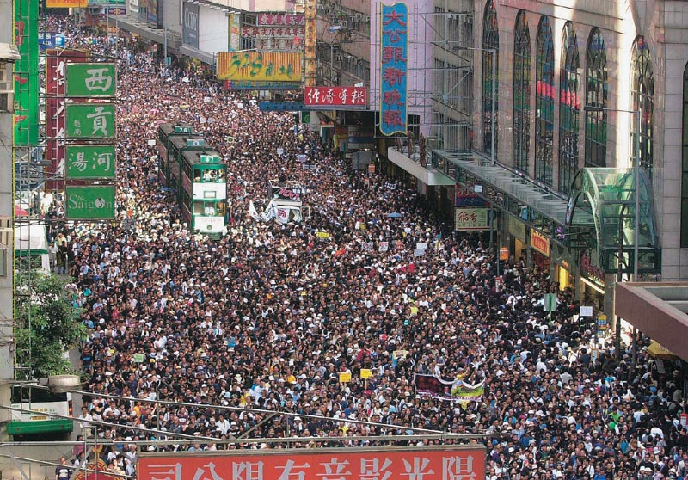

Slide 13
社會情況 – 年青人 Social Situation – Young People
高學歷、低就業
Well educated; Low employment

Slide 14
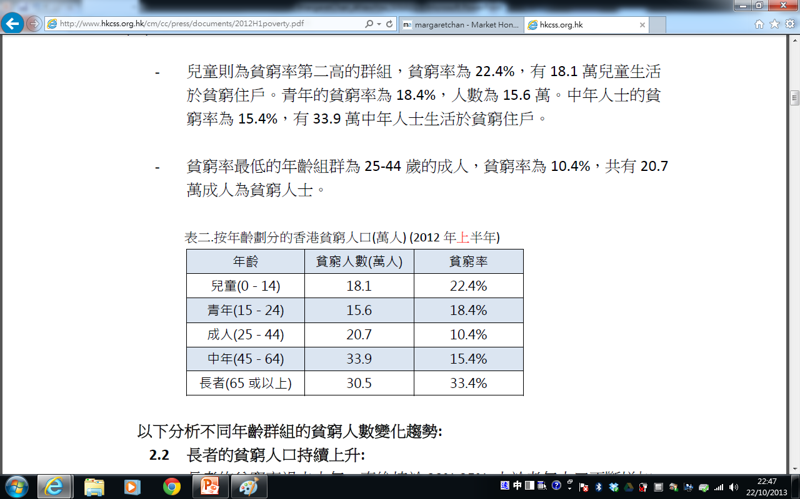
Poverty rate of youth in Hong Kong: 18.4% (156,000 people).
(資料來源：政府統計處)

Slide 15
社會情況 – 年青人 Social Situation – Young People
有創意、有夢想、有拼勁
They have creativity, dreams and spirits

Slide 16
社會情況 – 在職人士 Social Situation – Working People
就業壓力、上車壓力、家庭壓力、無時間
Employment pressure; Stress from buying a house; Family stress; No Time Freedom

Slide 17
中產思移民、不做樓奴咁簡單？ Middle Class Emigrating for Multiple Reasons
據保安局數字，今年上半年有3,900名港人移居外地，較去年同期上升8.3%，主要目的地是美國、澳洲、加拿大等，令人擔心是否會再有移民熱。
誠然，本港樓價高得驚人，今年1月美國機構Demographia發表全球住房負擔報告，本港在全球337個大城市中連續3年居榜首，即最難置業城市，樓價達到家庭年收入的13.5倍，遠高於第二位的溫哥華（9.5倍）。相信不少港人也會心想，與其窮盡一生買「蝸居」，倒不如到外地買一間較大的房屋享受？
According to the Security Bureau, 3,900 Hong Kong residents emigrated from Hong Kong in the first six months of this year (an increase of 8.3% compared with the corresponding period last year). Major emigration destinations include USA, Australia and Canada. There is a concern over another wave of mass migration.
The housing prices in Hong Kong are shockingly high. According to the Demographia International Housing Affordability Survey published in January, Hong Kong ranked the most unaffordable market in 3 consecutives years among 337 cities, with a Median Multiple of 13.5, much higher than that of Canada (9.5) which ranked the second. It is believed that many Hong Kong people will consider moving abroad for a better living environment than spending all their money on a small flat in Hong Kong.
(資料來源：經濟日報2013年9月4日) Source: Hong Kong Economic Times (4/9/2013)

Slide 18
社會情況 – 在職人士 Social Situation – Working People
有能力、有經驗
Capable and experienced

Slide 19
社會情況 – 退休人士 Social Situation – Retired
強積金？老人福利？再工作？
MPF? Elderly welfare? Still working?

Slide 20
THE 45 YEAR PLAN
在年滿65歲的每100個人中…
For every 100 people who should have reached the age of 65…
4%財務穩健
Financially Fit
1%富有
Wealthy
5%仍在工作
Still working
28%已逝世
Dead
62%貧窮/身無分文
Struggling Financially

Slide 21
THE 45 YEAR PLAN
在年滿65歲的每100個人中…
For every 100 people who should have reached the age of 65…
4%財務穩健
Financially Fit
95%人花上人生45年時間造就其餘5%人的成功！
他們的計劃是為他人的財務成功而努力，而不是為他們自己！
1%富有
Wealthy
5%仍在工作
Still working
95 percent of people spend up to 45 years of their lives making the other 5 percent successful!
They work a plan for someone else’s financial success
– not their own!
28%已逝世
Dead
62%貧窮/身無分文
Struggling Financially

Slide 22
社會情況 – 退休人士 Social Situation – Retired
社會經驗豐富、人際關係豐富
Extensive social experience and interpersonal skills

Slide 23
社會情況 – 做生意人士 Social Situation – Business Owners
成本上升、租金壓力、大集團壟斷
Rising costs; Rental pressure; Monopoly by large groups

Slide 24
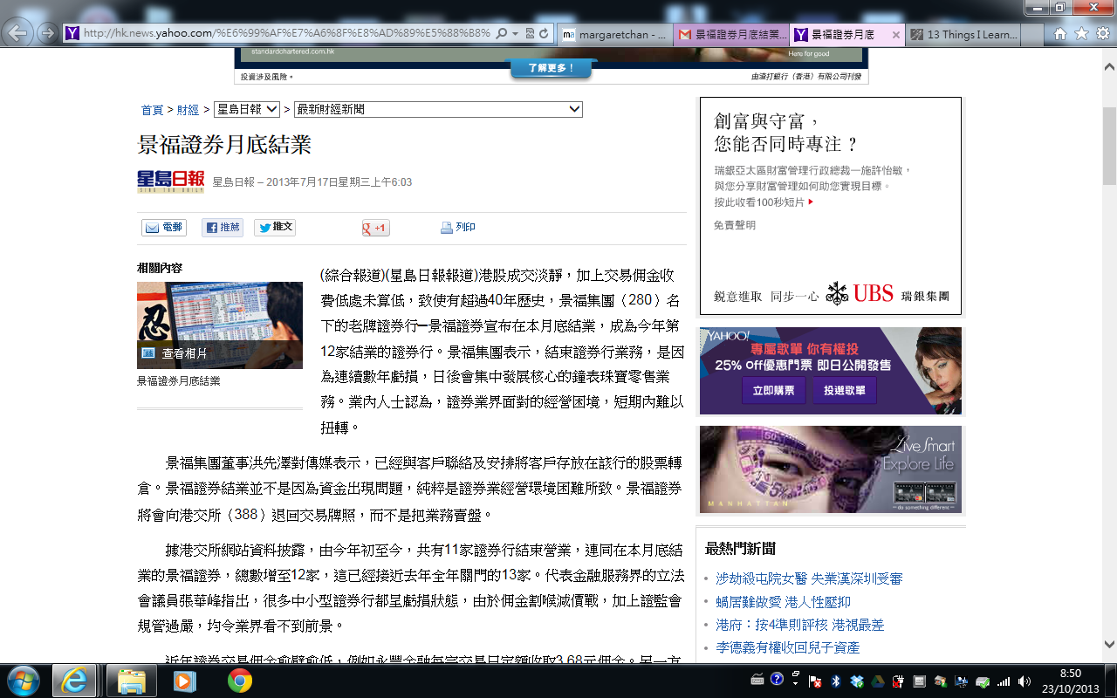
King Fook Securities Closes Down End of the Month

Slide 25
社會情況 – 做生意人士 Social Situation – Business Owners
有投資心態、有企業家精神、管理能力
Investor mindset; Entrepreneurship; Management skills

Slide 26
解決方案

Slide 27
美安公司的宗旨，在於提供一個證實可行的系統，讓有心創業的人士皆有機會創造永續收入，並為全球的消費者提供更好的購物模式。透過革新的科技與眾人的力量，我們正在開創未來的新經濟。 Market America’s mission is to provide a proven system for entrepreneurs to create an ongoing income, while providing consumers worldwide with a better way to shop. Through revolutionary technology and the power of people, we are creating the economy of the future.
…………………………………………………
成立於 1992年
ESTABLISHED
IN 1992
今曰
NOW

Slide 28
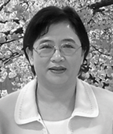
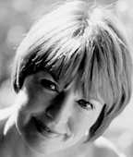
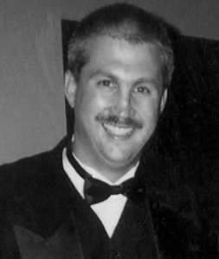
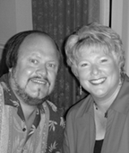
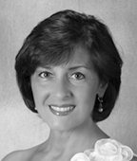
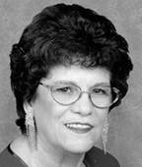
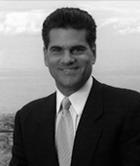
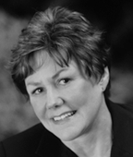
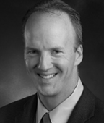
成功可以有不同面孔、不同背景、不同個性 People with different faces, different backgrounds and different personalities can succeed
佣金收入超過百萬美元
EARNED OVER ONE MILLION DOLLARS IN COMMISSIONS
估計總零售利潤†:
Total estimated retail profits earned:
US$1,265,058,282
+
總佣金:
Total commissions earned: US$1,257,468,708
=
經銷商總收入:
Total Distributor earnings : US$2,522,526,990*
*截至2012年3月31日止，估計零售利潤根據建議零售價計算 As of March 31, 2012, based on suggested retail prices.

Slide 29
SHOP.COM
轉換支出成為收入
Converting Spending Into Earning
ma
cashback

Slide 30
夢想 Dream

Slide 31
What’s the difference between a man without a dream and salted fish?!

Slide 32
夢想不會逃走 ，
逃走的往往只是自己。
Dreams do not escape.
It is always you who escapes.

Slide 33
Changed more than 40 jobs
Worked in more than 15 industries
Longest job: 2 years
轉工超過 40 份
轉行業超過15 個
最長1份工作 2 年多

Slide 34
過去的我 The Old Me
1) 率直
Blunt
2) 在意別人看自己
Cared about others’ opinions

Slide 35
改變 CHANGE

Slide 36
你喜歡你現在的生活嗎 ? Do you like your current life?

Slide 37
世界上的一切都在改變，
唯一不變的是“世界上的一切都在改變”
Everything in the world is changing. The only constant is CHANGE.

Slide 38
經營美安 TIPS TIPS on Running MA Business

Slide 39
行動 Action
成功5要訣
起步指南
基本10，7 人強
Basic 5
Getting Started Guide
Base 10, 7 Strong

Slide 40
每早起來有良好態度
Wake up with good attitudes
展示紅利計劃
Show the Plan
讀目標宣言
Read your goal Statement
MPCP
聽錄音
Listen to Audios
我這樣做了嗎？ Did I do this?
我的團隊有這樣做到嗎？
Does my team do this?
跟進、跟緊
Follow up closely
每天做甚麼？What should you do every day?
持續學習
知識與技巧
Learn constantly: Knowledge and skills
尋找需要財務獨立、
時間自由的人
Look for people who want
financial independence
& time freedom
為自己今天成果
稱讚自己
Praise yourself for today’s result
行動再行動
Action, Re-action

Slide 42
盲點 Blind Spots
尋找解決方案 vs 分享問題
行動量
衡量、監控、檢視、調整行動（質素）
意志力
Seek Solution vs Share Problems
Action
Measure, Monitor, Evaluate, Adjust (Quality)
Willpower
跟團隊合作、跟公司合作
Cooperate with your Team
Cooperate with SHOP.COM
面對它，克服它
Face and overcome it

